Slide 1



Spring Templates Spring on Webapp
Session
10
Chaim Turkel
Ido Barash

Slide 2


Last session - Spring AOP
Spring Core structure
Aspect Oriented Programming
AOP solutions
Spring AOP – Dynamic proxy
AOP – Joinpoints, Pointcuts,
Aspects via XML.
Aspects via Annotations.

Slide 3
Spring templates and webapp
Spring templates – JDBC template
Spring templates – Transaction template
Spring on web application

Slide 4

Spring Templates
Spring framework provide us with out-of-the-box templates for common tasks:
Transactions
JDBC queries executions
HTTP Rest calls
JMS calls
These tasks are quite identical in most applications and usually result in a lot of boilerplate code.
Spring templates wrap these standard operations with friendlier APIs and with friendlier exception handling.

Slide 5
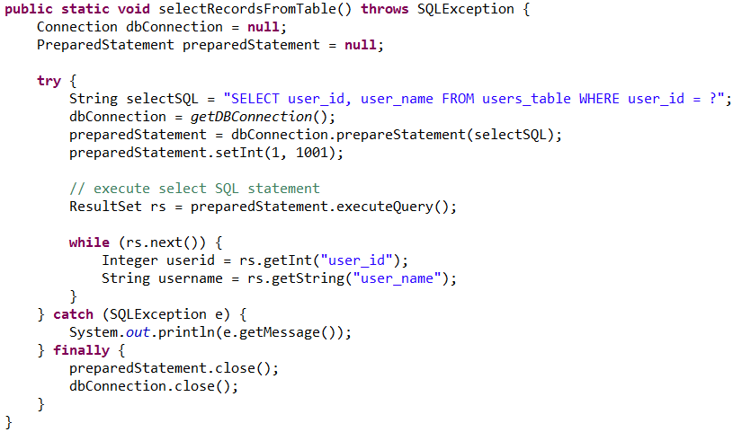
Spring Templates - JDBC
Normal JDBC usage example:

Slide 6
Spring Templates - JDBC
Normal JDBC usage example:
Actual method code

Slide 7
Spring Templates - JDBC
Normal JDBC usage example:
Boilerplate code

Slide 8
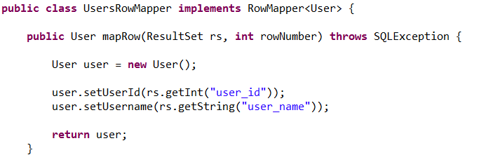
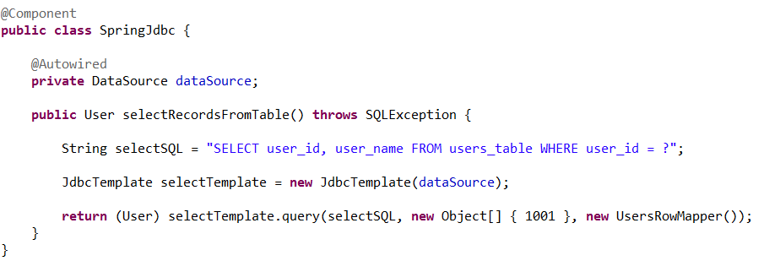
Spring Templates - JDBC
Spring JDBC template usage example:

Slide 9
Spring Templates - JDBC
Spring JDBC template usage example:
No biolerplate code!

Slide 10
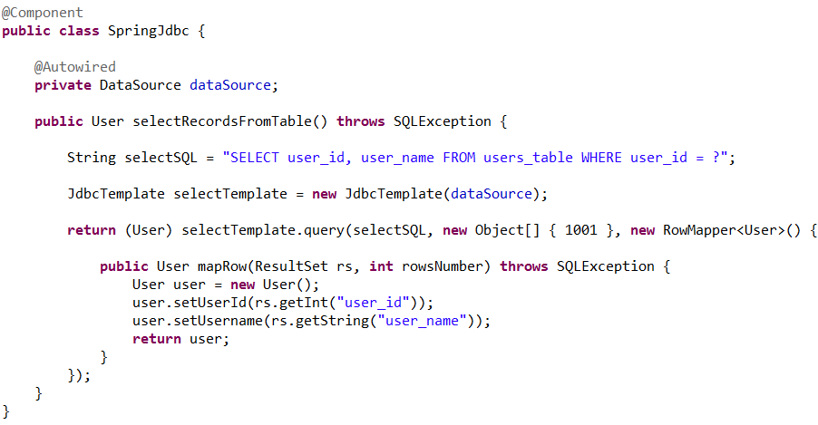
Spring Templates - JDBC
Spring JDBC template usage example – inline mapper class:

Slide 11
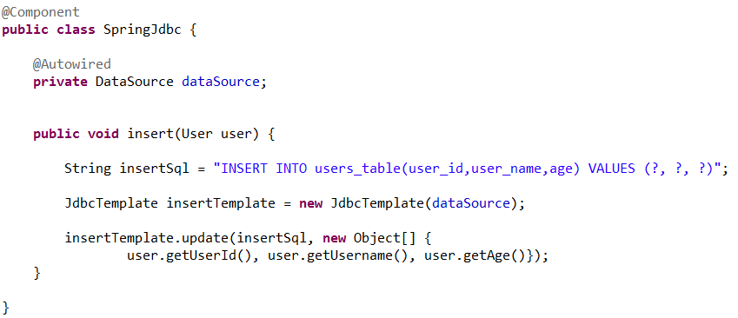
Spring Templates - JDBC
Spring JDBC template usage example – Insert:

Slide 12
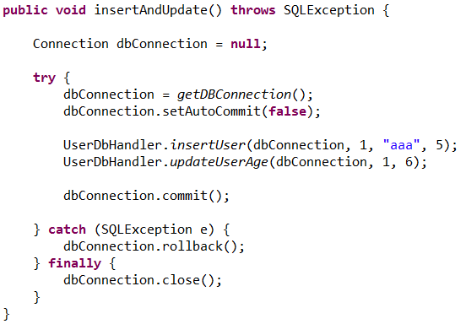
Spring Templates - Transaction
Normal JDBC transaction example:

Slide 13
Spring Templates - Transaction
Normal JDBC transaction example:
logic

Slide 14
Spring Templates - Transaction
Normal JDBC transaction example:
Boilerplate code

Slide 15
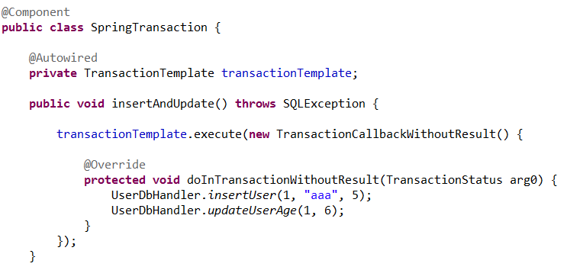
Spring Templates - Transaction
Spring transaction template example:

Slide 16
Spring Templates - Conclusion
Spring offers several templates to make some development tasks much more easy.
Easy to use.
Reduce code.
Spring templates are no magic – there are just wrappers that mask boilerplate code.

Slide 17
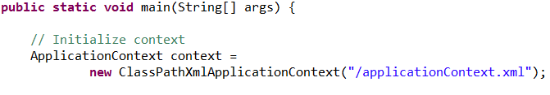
Spring on Web-app
Till now, we used Spring as a container of very simple java projects.
We used main method to initialize Spring and create all our context beans.

Slide 18
Spring on Web-app
Till now, we used Spring as a container of very simple java projects.
We used main method to initialize Spring and create all our context beans.
But what about full scale web-applications?

Slide 19
Spring on Web-app
Web-apps are deployed via WAR files.
Web-apps has no main method.
Web-apps are initialized by the application server.

Slide 20
Spring on Web-app
Web-apps are deployed via WAR files.
Web-apps has no main method.
Web-apps are initialized by the application server.
So, How do we integrate Spring?

Slide 21
Spring on Web-app
We add a special listener class, created by Spring, to the deployment descriptor file (web.xml)
Listener is an object that waits for a specific event to happen. Then, the listener “hijacks” the event and do something else.
<context-param>
<param-name>contextConfigLocation</param-name>
<param-value>classpath:applicationContext.xml</param-value>
</context-param>
<listener>
<listener-class>
org.springframework.web.context.ContextLoaderListener
</listener-class>
</listener>

Slide 22
Spring on Web-app
On deployment, Spring listener will run and initialize all the beans and inject their dependencies.
Notice: Servlets and JSPs are created by the server. They can not be instantiated, injected or have their dependencies injected by Spring.

Slide 23
Spring on Web-app
Servlets are obsolete – So most of the time we don’t need to integrate them with spring.
But if we do, we override the servlet’s init() method and use Spring special static method to inject dependencies.
@WebServlet("/users")
public class UsersServlet extends HttpServlet {
@Autowired
private UserBusinessService userBusinessService;
public void init(ServletConfig config) throws ServletException {
super.init(config);
SpringBeanAutowiringSupport.processInjectionBasedOnCurrentContext(this);
}
}
e

Slide 24
Spring on Web-app
Servlets are obsolete – So most of the time we don’t need to integrate them with spring.
But if we do, we override the servlet’s init() method and use Spring special static method to inject dependencies.
@WebServlet("/users")
public class UsersServlet extends HttpServlet {
@Autowired
private UserBusinessService userBusinessService;
public void init(ServletConfig config) throws ServletException {
super.init(config);
SpringBeanAutowiringSupport.processInjectionBasedOnCurrentContext(this);
}
}
e

Slide 25
Spring templates and webapp
Spring templates – JDBC template
Spring templates – Transaction template
Spring on web application

Slide 26
Next session: Web-services
Web-services introduction
JAX-B
JAX-WS (SOAP)

Slide 27

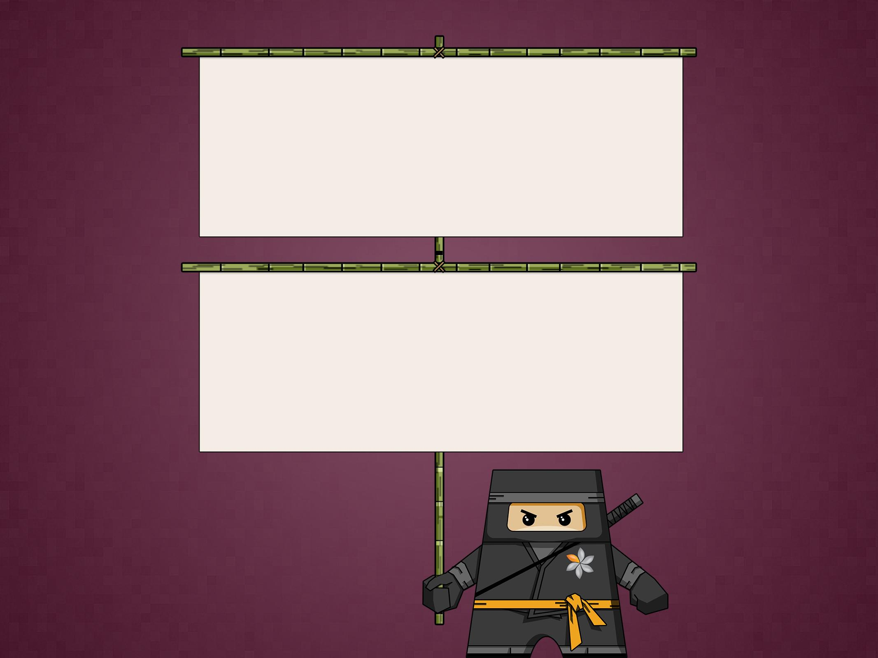
THANK YOU
Ido Barash
Email: ido.barash@tikalk.com

